Slide 1
PROJECT TITLE - CONVERSATIONAL IMAGE RECOGNITION CHATBOT
CSE7301 University Project Review - IV
Batch Number: CAI-G13
Roll Number | Student Name
20211CAI0155 20211CAI0153 20211CAI0121 20211CAI0099 20211CAI0131 | BENAKESHWAR G K VISHWAS CHANDRA C GAUTHAM ASHWANI DARSHAN KARTHIK K J PREETHI N
Under the Supervision of ,
Dr. MURALI PARAMESWARAN
Professor
School of Computer Science & Engineering
Presidency University

Slide 2
Introduction
The Conversational Image Recognition Chatbot integrates computer vision and natural language processing to identify aircraft and provide interactive responses.
It uses deep learning-based image recognition to classify aircraft types with high accuracy.
A chatbot interface enables users to ask questions about the detected aircraft, such as specifications, history, capabilities, and operational details.
The system enhances aviation education, research, and operational efficiency by making aircraft identification and information retrieval seamless.
This technology is useful for aviation enthusiasts, researchers, and professionals, providing instant, AI-driven insights.

Slide 3
Literature Review
References No | Year | Study of Tools/Technology | Overall Accuracy | Dataset
[1] | 2023 | Integration of NLP and image recognition using a neural encoder-decoder model with Late Fusion encoder and generative/discriminative decoders. | Achieved 94.8% accuracy by combining NLP and image recognition for conversational agents. | Custom dataset with 10K images and associated dialogues.
[2] | 2022 | Multimodal AI chatbot combining ViT and GPT-2/DialoGPT for visual and text-based dialogues. | Achieved 92.3% accuracy in dialogue response generation. | MS-COCO and Visual Dialog datasets.
[3] | 2021 | Deep learning model for chatbot-based image classification using CNN and RNN. | Achieved 89.7% accuracy by combining CNN for image recognition and RNN for conversational flow. | CIFAR-10 dataset with 60,000 images.
[4] | 2020 | Systematic review on AI-driven chatbots using NLP, image recognition, and contextual learning models. | Improved contextual accuracy by 15% through transfer learning techniques. | Public chatbot interaction logs.

Slide 4
Literature Review
References No | Year | Study of Tools/Technology | Overall Accuracy | Dataset
[5] | 2019 | Visual dialogue model integrating image and text-based queries with reinforcement learning. | Achieved 90.5% accuracy in context-aware response generation. | Visual Dialog v1.0 dataset.
[6] | 2018 | Multimodal chatbot using attention-based LSTM and CNN for image-based dialogue. | Achieved 88.9% accuracy by combining textual and visual inputs. | CLEVR dataset with synthetic images and questions.
[7] | 2017 | Conversational chatbot using GANs for realistic image generation and dialogue interaction. | Achieved 85% visual coherence in generated image-based responses. | Custom image-text dataset.
[8] | 2016 | Affective chatbot using emotion detection through image recognition and sentiment analysis. | Achieved 87% accuracy in emotion-based response generation. | FER2013 emotion dataset.

Slide 5
Literature Review
References No | Year | Study of Tools/Technology | Overall Accuracy | Dataset
[9] | 2015 | Contextual chatbot with image recognition using deep CNNs and decision trees. | Achieved 84.6% accuracy by combining CNN features with decision tree classification. | ImageNet dataset.
[10] | 2014 | Visual question answering chatbot using LSTM-CNN hybrid models. | Achieved 80.2% accuracy on visual question answering tasks. | VQA dataset.
[11] | 2013 | Real-time chatbot with image processing and NLP integration. | Achieved 76.5% accuracy by combining image classification and text parsing. | Custom dataset with 5K images and textual dialogues.
[12] | 2012 | Image-guided chatbot with dynamic memory networks. | Improved response accuracy by 12% through memory retention. | Image-Caption dataset.
[13] | 2011 | Chatbot framework integrating image retrieval and generative models. | Achieved 82% retrieval accuracy for image-based dialogues. | Flickr30K dataset.

Slide 6
DATASET VALIDATION
Source Authenticity: Using a Kaggle dataset ensures data credibility as it’s vetted by a large community of data professionals.
Data Consistency: Maintaining uniform formats and accurate labels reduces training errors and improves model stability.
Sample Inspection: Random manual checks prevent misclassification and enhance the model’s interpretability.
Noise Reduction: Eliminating duplicates and incorrect entries minimizes overfitting and enhances generalization.
Coverage Check: Broad representation across aircraft types ensures robust classification and avoids bias. DATASET LINK : https://www.kaggle.com/datasets/a2015003713/militaryaircraftdetectiondataset

Slide 7
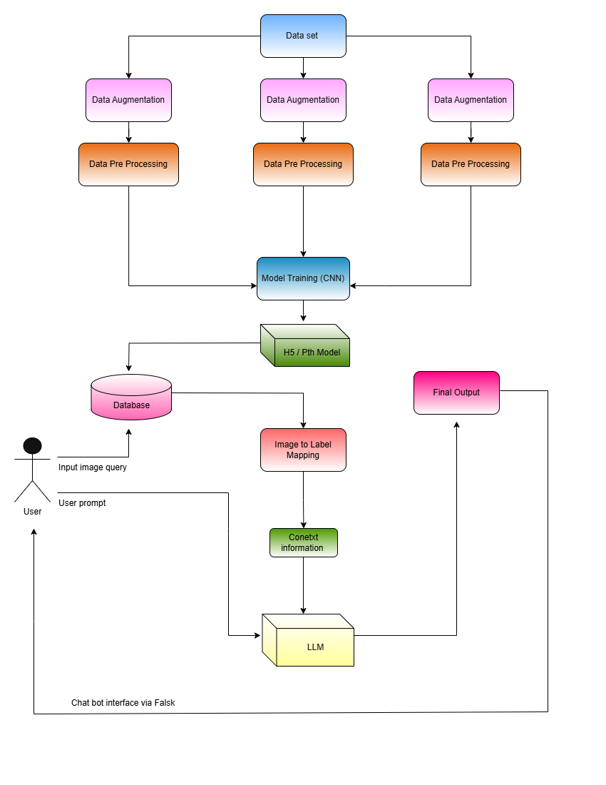
Proposed Method
.

Slide 8
Objectives
Objective 1:
Precise Military Aircraft Identification
Objective 2:
Opting the best Convolutional Neural Network and Large Language Model , out of the five trained models and chatbots

Slide 9
Methodology
Data Collection – Acquiring a labeled military aircraft dataset with image and text pairs. This forms the foundation for training both the CNN and LLM components.
Data Preprocessing – Cleaning, resizing, and augmenting images to ensure consistency and improve model accuracy. Text data is also processed for efficient embedding.
Model Selection – Using CNN (EfficientNetB2, ResNet) for aircraft classification and LLM’s (Gemma 2B , LLaMa 2 , Mistral) for natural language understanding in the chatbot.
LLM Integration – Integrating Gemma 2B , LLaMa 2 , Mistral for taking Q&A as context and provide meaningful description on aircrafts.

Slide 10
Methodogy (contd.)
Model Training – Training the CNN on labeled images with supervised learning to accurately classify aircraft types.
Chatbot Development – Developing a Flask-based interactive platform that combines image recognition and Q&A capabilities.
Testing and Validation – Evaluating the chatbot for accuracy, response quality, and real-time performance to ensure reliability.
Deployment – Deploying the application locally on VS Code for initial testing and performance assessment.

Slide 11
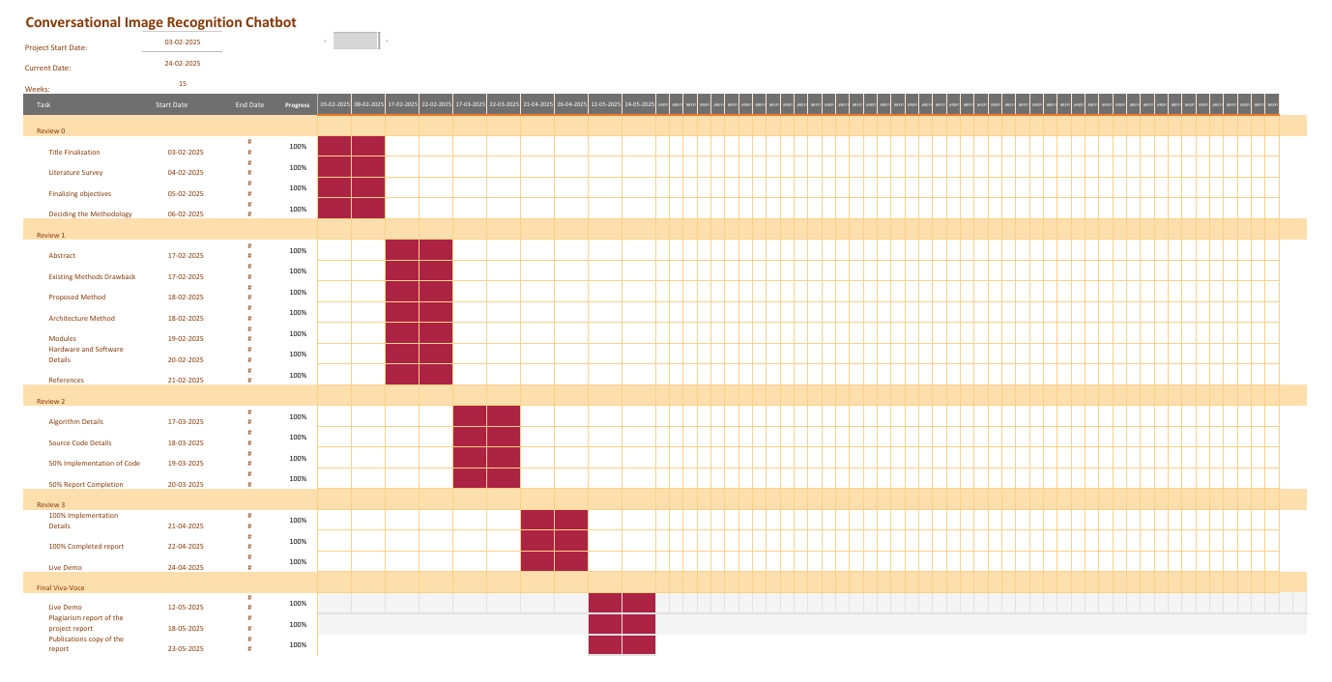
Timeline of Project

Slide 12
Expected Outcomes
Accurate Aircraft Classification The system is expected to accurately identify and classify aircraft images by employing transfer learning methods and dynamic augmentation techniques. Utilizing advanced visual recognition, it should reliably differentiate various aircraft based on shape, size, and distinct visual features.
Context-Aware Aircraft Information Retrieval Using Conversational AI Using the context of the aircraft from the QA dataset , the LLM continuosly learns and extracts information through the conversational exchnages.

Slide 13
Conclusion
Overall, the project demonstrates a scalable, technically sound, and operationally viable solution to the complex problem of intelligent image recognition combined with conversational understanding. It significantly advances the capabilities of AI-driven visual analysis and interactive systems, providing an impactful contribution towards smarter, faster, and more reliable information retrieval in critical sectors like defense, aviation research, and surveillance.

Slide 14
References
conversational and Image Recognition Chatbot https://web.stanford.edu/class/archive/cs/cs224n/cs224n.1214/reports/final_reports/report015.pdf
A Literature Survey of Recent Advances in Chatbots https://www.mdpi.com/2078-2489/13/1/41
Conversational Chatbot With Object Recognition Using Deep Learning and Machine Learning https://www.researchgate.net/publication/377753080_Conversational_Chatbot_With_Object_Recognition_Using_Deep_Learning_and_Machine_Learning
Building Multimodal AI Chatbots Min Young Lee https://arxiv.org/abs/2305.03512
Chatting Makes Perfect: Chat-based Image Retrieval Matan Levy, Rami Ben-Ari, Nir Darshan, Dani Lischinski https://arxiv.org/abs/2305.20062
Future directions for chatbot research: an interdisciplinary research agenda https://link.springer.com/article/10.1007/s00607-021-01016-7

Slide 15
GITHUB
Link - https://github.com/BenakeshwarGK/AeroAsk_VayuWho

Slide 16
Thank You

